Slide 1
Functions & Activities Andy Crooks, Stroma

Slide 2
In today’s session:
The BICOF requirements
Code of Conduct obligations
Our functional requirements
How we perform our activities
Plan checking
Inspections
When things go wrong

Slide 3
BICOF General Requirements
Level A – Awareness
Restricted functions
RBCA’s roles
Level B – Appreciation
Roles of individuals – admin, inspectors, managers & Dutyholder responsibilities
Processes associated with delivery
Level C – Understanding
Functional delivery per the RBI Code of Conduct
Level D – Comprehensive understanding
Functional delivery per the RBI CoC, including non-standard buildings and HRBs

Slide 4
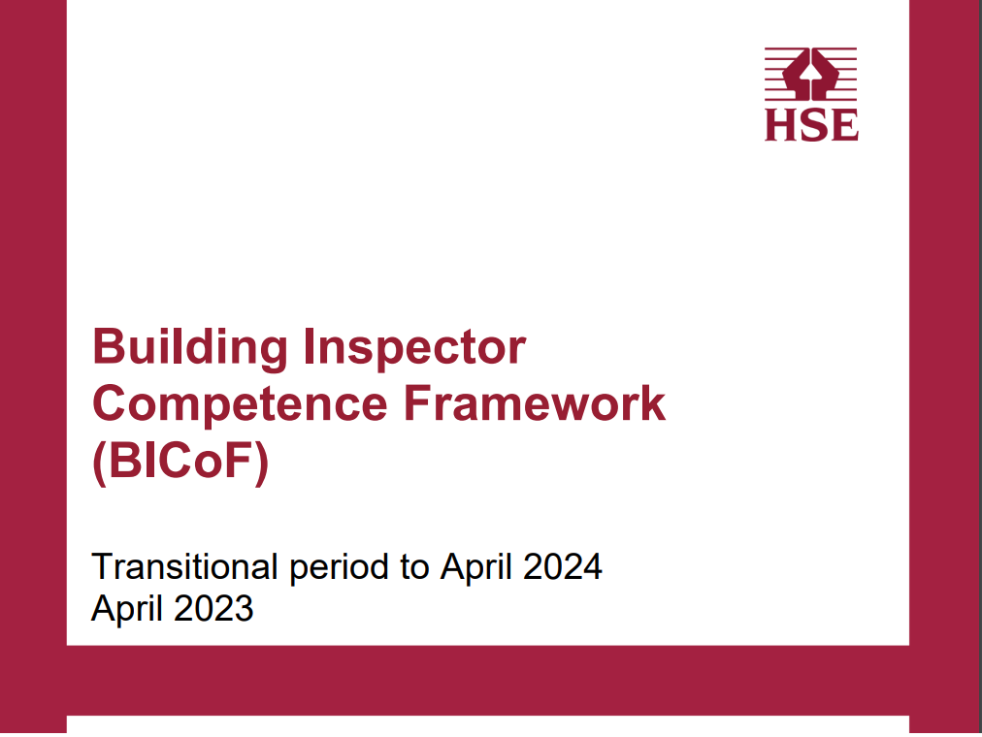
Roles and competence levels
Class 1 Trainee Building Inspector – Competent to level A and B
Class 2 Building Inspector – to level C
Class 3 Specialist Building Inspector – to level C
Class 4 Technical Manager – to level D

Slide 5
Legal Background
The Building Safety Act 2022
The Building Act 1984
The Building Regulations 2010 (as amended)
The Building (Approved Inspector etc.) Regulations 2010 (as amended)
The Building (Restricted Activities and Functions)(England) Regulations 2023
The Building (Higher Risk Buildings Procedures)(England) Regulations 2023
Regulatory Reform (Fire Safety) Order 2005
The Fire Safety Act 2021
The Fire Safety England Regulations 2022

Slide 6
Regulatory Framework

Slide 7
The Building (Restricted Activities and Functions) (England) Regulations 2023
Restricted activities –
Checking plans
Inspecting work
Restricted functions –
For LAs – undertaking certificated functions
For BSR – Same
For RBCAs – Giving notices and certificates etc.
Offence to work outside of scope of registrations, so don’t.
Notes:
46ABuilding control authorities: restricted activities and functions
(1)A building control authority may carry out a restricted activity in relation to any work only through a registered building inspector, acting on the authority’s behalf, whose registration has effect in relation to work of that description.
(2)Before each exercise of a restricted function in relation to any work, a building control authority must obtain and consider the advice of a registered building inspector whose registration has effect in relation to work of that description.
(3)The registered building inspector who carries out the restricted activity, or advises on the exercise of the restricted function, may (but need not) be employed by the authority.
(4)In this section—
“restricted activity” means an activity that is prescribed for the purposes of this section;
“restricted function” means a function of a building control authority under—
(a)
this Part,
(b)
Part 3, or
(c)
regulations made under this Part or Part 3,
that is prescribed for the purposes of this section.”
(3)After section 54A (inserted by section 47) insert—
“Registered building control approvers: restricted activities and functions
54BRegistered building control approvers: restricted activities and functions
(1)This section applies to a registered building control approver who is not a registered building inspector.
(2)The approver may carry out a restricted activity in relation to any work only through a registered building inspector, acting on the approver’s behalf, whose registration has effect in relation to work of that description.
(3)Before each exercise of a restricted function in relation to any work, the approver must obtain and consider the advice of a registered building inspector whose registration has effect in relation to work of that description.
(4)The registered building inspector who carries out the restricted activity, or advises on the exercise of the restricted function, may (but need not) be employed by the approver.
(5)In this section—
“restricted activity” means an activity that is prescribed for the purposes of this section;
“restricted function” means a function of a registered building control approver under this Part, or regulations made under this Part, that is prescribed for the purposes of this section.
(6)A registered building control approver who contravenes subsection (2) or (3) without reasonable excuse commits an offence.
(7)An offence under this section is punishable on summary conviction by a fine.”

Slide 8
Function of an Approved Inspector
It will likely be the same for a Registered Building Control Approver
Given in Regulation 8 of the AI Regulations:
To take such steps as are reasonable within the limits of professional skill and care to check compliance with the relevant building regulations.
So, what is relevant?

Slide 9
Essentially our role is split into four parts:
Check technical compliance:
Does the work meet the requirements for building work?
Evidence provided by pre-construction information, plan checks, site inspections, consultations, declarations
Commissioning & post-construction stage information:
Emission rates, water efficiency, competent person declarations, EPCs, Acoustics testing, airflow tests, pressure tests etc.
Checking declarations made by the person responsible for work:
Regs 16(E),38, 39, 40 and 44 declaration and appropriate commissioning
Checking Part 2A (dutyholder and competence)
Notes:
Does the work likely comply with Regs 4 and 6. Are there any doubts that it complies with Reg 7. Reg 22 a change in energy status, Reg 23 Requirements for thermal elements, Reg 28 consequential improvements.
Self-explanatory
3.
in each instance – you need to have confirmed that info has been passed to relevant parties:
Fire safety information to the responsible person for any building of relevant use (Reg 38)
Information about ventilation (Reg 39)
Information about the use of fuel and power (Reg 40)
Notice confirming that the fixed services have been appropriately commissioned.
You don’t need the information itself – just confirmation it has been passed.
This becomes more important due to the nuance of Reg 38 – we will go through this later.

Slide 10
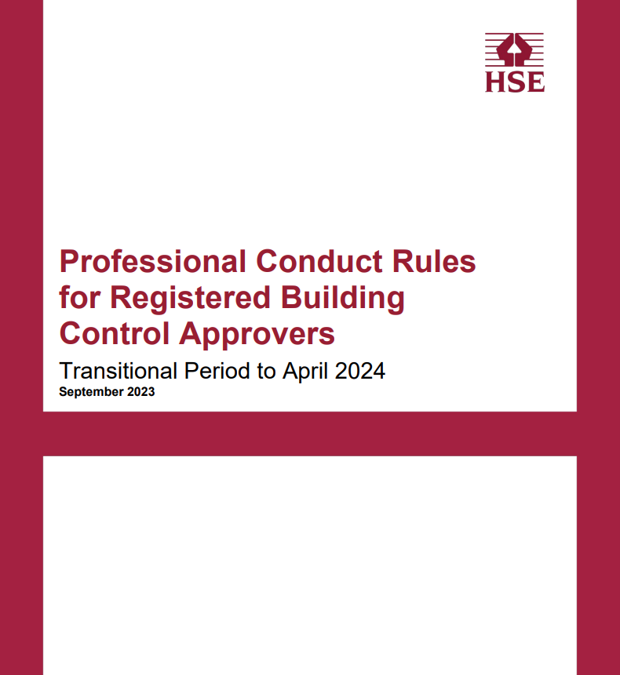
Professional Conduct Rules for RBCAs
Principles
Act with Honesty
Act with Integrity
Maintain Professional Competence
Deliver services with professional skill and care
Uphold public Trust and confidence
Treat everyone fairly and act by your legal obligations

Slide 11
Professional Conduct Rules for RBCAs
Professional Standards:
Complying with legal, regulatory and professional obligations
Business Requirements
Professional Competence and CPD
Standards of Service
Engaging with Clients
Annex 1 – Obligation to the Regulatory Authority
Annex 2 – Provision of information to applicants of agents
Annex 3 – Rules of Registration
Annex 4 – Registration conditions
Annex 5 - Acting within the scope of registration
Notes:
1.1 You must comply with all relevant legal and regulatory requirements:
in the conduct of work activities;
relating to the enforcement of compliance linked to work activities within the profession; and
which apply to the conduct of your business activities, for example anti money laundering, anti-bribery and corruption, data protection and Equalities Act 2010.
1.2 You must comply with your obligations to the Regulatory authority under the PCR, as set out in Annex 1 and any obligations to other regulatory authorities, local authorities or professional bodies.
1.3 You should comply with industry standards and consider best practice where appropriate.
1.4 You must maintain professional independence and impartiality in the conduct of work activities.
1.5 You must not act in a manner that is likely to bring the building control profession into disrepute.
1.6 You must take appropriate steps to ensure that activities undertaken by individuals under your supervision comply with relevant legal and regulatory requirements.
1.7 Where you become aware of a breach of the Building Act 1984 (as amended), or associated legislation, you must use your regulatory powers to secure compliance. If you are unable to secure compliance within a reasonable timescale, you must report noncompliant works to the relevant Local Authority.
1.8 You must work in a co-operative manner with fire and rescue services, statutory undertakers, and similar organisations.
1.9 You must make sure that the terms 'registered building control approver’, ‘RBCA’, ‘registered building inspector’ and ‘RBI’ are used accurately and conform to the terms of your registration with the Regulatory authority. Professional conduct rules for Registered Building Control Approvers
1.10 You must not give design advice, or act as a principal designer, in your professional capacity as an RBCA.
2 Business Requirements:
Hold appropriate insurance
Sensible financial management
Written policies and procedures – conflicts, h, s and wellbeing, antibribery, data protection, whistleblowing, complaints, learning and development, staff conduct, equality, diversity and inclusion.
3, Competence & CPD
Only undertake work for which JHAI is and the staff are competent to undertake.
Must ensure that any inspector is on the register at the right level
Must comply wit the OSRs – see policy
Must ensure suitable management of developing individuals
Must maintain the competence levels
Effective monitoring
Must keep records for 5 years.
Provide training on the business areas about which we have just been talking
Standards of service
Must act - Fairly and objectively, diligently, conscientiously, best interests of the profession when dealing with individuals
Must conduct – apply governance arrangements, remain accountable for decisions and delegated work, for the work we supervise
Must take a quality driven approach
Everyone must understand their roles and responsibilities and any restrictions
Must not be influenced by self-interest, prejudice, bias or a personal agenda
Don’t do the work if you don’t have the resource
Must always be able to work per the OSRs and meet the KPIs.
We must provide info on request (having regard to privacy laws and payment)
We must retain evidence, instructions, records of advice, judgements and decisions.
Engaging with clients:
Must have an accessible service
Establish and explain stuff to clients
State any license restrictions
Establish and act per the contract terms
Have clear and transparent policies
Must treat material as confidential. Within certain given limits and make sure the client is aware.

Slide 12
Transitional Code of Conduct For Registered Building Inspectors
The principles are just a repeat of the Professional Conduct Rules
The standards
Complying with legal, regulatory and professional obligations
Workplace requirements
Maintaining competence & CPD
Standards of service
Engaging with applicants and agents
Annex 1 – Obligations to Reg Auth.
Annex 2 – Provision of information to applicants and agents
Notes:
Workplace requirements –
2.1 Where applicable, you must only undertake work for which we are insured
2.2 Where applicable maintain suitable insurance
2.3 Duty to report complaints and claims in accordance with insurance conditions.
Financial propriety –
2.4 – Ensure professional finances are managed responsibly
2.5 - Adhere to accounting controls
2.6 – Don’t facilitate crime, including money laundering etc bribery and corruption
2.7 – Don’t price fix or engage in anti-competitive practices
2.8 – Ensure professional costs are fair and proportionate
Conflicts of interest –
2.9 Declare them before, during or after
2.10 Don’t work where there is a conflict
2.11 – Where one is identified, notify the applicant and agent and cease to act.

Slide 13
Operational Standards Rules
Applicable from 1 April 2024
Replaces the Building Control Performance Standards, which still apply until 31 March 2024
Due for imminent revision to the latest draft
Currently marked as draft
Systems and Controls
Persons
Building Control Functions
Enforcement and intervention
Strategic document
KPI information

Slide 14
Competence is primarily about us doing our job
Taking instructions
Quotes & prelim notes
Establishing contract
Checking plans
Issuing plan check tracker
Undertaking statutory consultations
Site inspections
Site inspection reports
Judging compliance
Gathering information
Initial Notice
Making amendments as required
Taking notices
Interventions and enforcement
Ensuring good com’s
Closing out
Compliance Statements
Certification and declarations
Issue Final, revert or cancel
Pass on relevant information

Slide 15
Class 3 Competence – the BSR and non-standard
Be familiar with:
How to deal with complex projects
The BSR application approach – MDT inductions
Principle-based approach to non-standard construction
Gateway 1
Planning gateway
Consideration of fire safety provisions
Gateway 2
Before works start on site
Stop/Go point
Applications must demonstrate compliance
Gateway 3
When works are complete
Stop/Go point
Dutyholders must demonstrate compliance
During construction between G2 and 3
The Golden Thread at handover
Regulation 38 & declarations
Change control & partial occupation plans
Completion Certificates
Fire Statements

Slide 16
Class 4 – Technical Managers
Ensuring the company meets its legal, regulatory and professional obligations
Resource Planning
Ensuring competence and adequate supervision/control of the workforce
A compliance-managed approach – standard of service
An enforcement-led approach – the aim is always to bring the job to a conclusion on time, having taken the appropriate actions

Slide 17
Summary
Read:
Codes of professional conduct and code of conduct
Read:
The Building Control Performance Standards policy
The Operational Standards Rules policy, when released
Ensure you know your legal function
Ensure you know what information and declarations need to be in place before you give a final certificate
This will protect you and the company
DO NOT work outside your scope without:
Being briefed by a person of suitable class
Getting your work checked

Slide 18
Thanks for listening
Any questions?

