Slide 1


Building Control Law

Slide 2

Introduction
As building control practitioners we are expected to have an understanding of Building Control Law and other building legislation. We probably have a better knowledge of this subject than we think particularly if we have a degree of experience.
The BICOF requires that we demonstrate this knowledge and it is the intention of this presentation to show how this can be done.

Slide 3
summary
This presentation will set out to:-
Go through the criteria levels set out in BICOF
List the legislation quoted in the BICOF
Run through creation of law
Explain difference between ACTs, Regulations and guidance documents.
Touch on new building regs.
Touch on enforcement responsibilities.
Run through demonstrating competence for BICOF

Slide 4
Level A criteria
Demonstrate awareness of principals of law including:-
skills, knowledge, experience and behaviours
competence criteria –
Principles of law include;
Review of building control related law; purpose, creation, development, including primary and secondary legislation, how organisational policies, procedures, and consultation relate to the application of the law.
How individual and organisational duties in design, construction, inspection, compliance, and enforcement support safe, sustainable buildings.
The legal status of other documents, such as Approved Documents and guidance
How the law, legal matters and behaviours are applied to achieve compliance,

Slide 5
Level B
Level B competence criteria – appreciation of:
• level A criteria
• how the law interacts with the building control functions, including both restricted activities and functions and non-restricted building control activities.

Slide 6
Level C
Level C competence criteria –
understanding of:
• level A and B criteria
• how to apply the law to secure compliance when undertaking building control activities, including plans assessment and inspections
• The enforcement powers available: their extent and limitations, when and how to apply them to secure compliance
• How the application of personal, technical and professional skills (relating to law) enhances the carrying out of building control activities and functions

Slide 7
Level D
Level D competence criteria –
comprehensive understanding of:
• level A, B and C criteria
• application of relevant legislation to non-standard buildings and HRBs

Slide 8
Main Legislation
The Building safety Act 1922 and secondary legislation.
The Building Act 1984 and secondary legislation.
The Building regulations 2010 and Associated approved documents.
The Fire Safety Act 2010
The regulatory Reform (Fire Safety) Order 2005
Fire Safety(England) Regulations 2022
The Building (Approved Inspectors etc) Regulations 2010

Slide 9
Other relevant Legislation.
Relevant Property and Land Law Party wall Act
Data protection Legislation GDPR
The Defective Premises Act 1972
The Safety of Sports Grounds Act 1975
Fire Safety and Safety of Sports Grounds Act 1987

Slide 10
English Law
Primary Legislation
Bill Drafted
House of Commons
House of Lords
Back to Commons
Royal Assent
Becomes Act
Interpreted by case law.

Slide 11
Secondary legislation
Statutory Instruments Known as Regulations.
Support Primary Legislation e.g. Building Regs supports parts of Building Act and Building Safety Act.
Considered by parliamentary committee.
Once scrutinized referred to Delegated Legislation Committee.
Formally Approved by House of Commons.

Slide 12
Application
Acts of parliament
Statutory instruments (regulations)
Department circulars. (explain regulations)
Approved Documents
Codes of Practice
Standards
Other guidance documents (BRE digests)
Data sheets
BBA

Slide 13
Example of Act
Building Safety Act 2022, Clause 58M
(1) A person who is not a registered building inspector commits an offence if, with intent to deceive, the person—
impersonates a registered building inspector, or
does anything (including using any name, title or description) which implies that the person is a registered building inspector.
(2) An offence under this section is punishable on summary conviction by a fine.

Slide 14
Building regulations.
The building regulations are basically definitions, procedural guidance and functional requirements.
There are three sets of regulations :-
High risk buildings
Principal regs including Local Authority Building control.
Approved Inspector Regulations

Slide 15
Requirements
Regulation 4
4 – Requirements Relating to Building Work
(1) Subject to paragraph (2) building work shall be carried out so that—
it complies with the applicable requirements contained in Schedule 1; and
in complying with any such requirement there is no failure to comply with any other such requirement.
(2) Where—
building work is of a kind described in regulation 3(1)(g), (h) or (i); and
the carrying out of that work does not constitute a material alteration,
that work need only comply with the applicable requirements of Part L of Schedule 1.
(3) Building work shall be carried out so that, after it has been completed—
any building which is extended or to which a material alteration is made; or
any building in, or in connection with, which a controlled service or fitting is provided, extended or materially altered; or
  work required by regulation 22 (requirements relating to a change of energy status);
  work required by regulation 23 (requirements relating to thermal elements);
  work required by regulation 28 (consequential improvements to energy performance).

Slide 16
Schedule 1
Functional requirements
Regulation 4 gives requirements relating to building work
Refers to schedule 1 which states functional requirements
Reasonable provisions shall be made………

Slide 17
Guidance Documents
Approved Documents give guidance of how to comply with the functional requirements for common types of buildings. They are often considered as Deemed to satisfy.
They refer to other guidance documents and standards.
Codes of practice give alternative and supplementary guidance to the Approved Documents.
Standards usually relate to product testing
Other guidance such as BRE digests can also help demonstrate compliance.

Slide 18
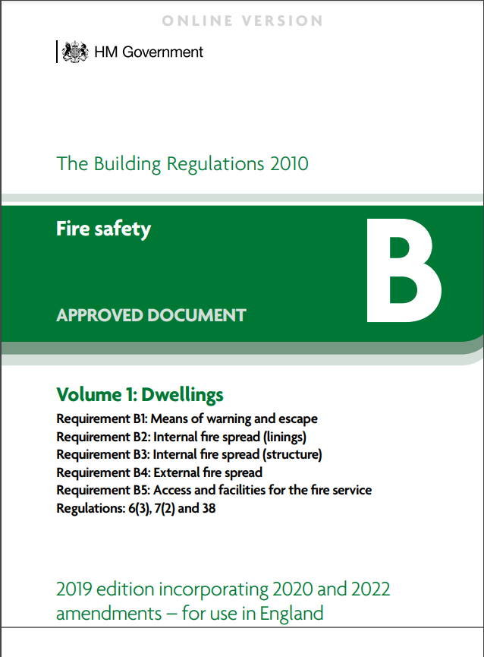
Approved documents

Slide 19
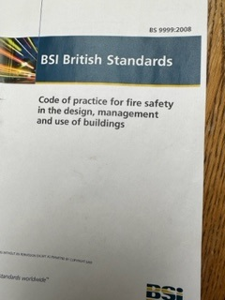
Codes of practice

Slide 20
Duty Holders
The building regulations set out responsibilities of duty holders.
Responsibilities are set out for the Client, the designers and the contractors for a project.
They include passing on information, compliance and taking responsibility.
The duty holders details must be given to building control body and the duty holder must give statements of compliance before a final certificate is issued.

Slide 21
Building Inspectors
Only registered Building Inspectors can carry out restricted functions of plan checking and site inspections.
They must carry out work within their Class of registration
They must be reapproved every 4 years.
It is a criminal offence to impersonate an RBI

Slide 22
Enforcing Bodies
Applications must be made to enforcing body
Building Safety regulator for High risk buildings.
The Local authority are the common enforcement authority for building control
Work can be certified as compliant by others.
      Approved Inspectors (Registered Building Approvers)
      Competent persons
      Public Bodies
5. If non non compliant enforcement made under section 35 and 36 of building Act
Appeals can be made
6. Fire authorities have powers to prohibit parts or all of premises.(FSO)
7. HSE oversees Building Control bodies.

Slide 23
Demonstrating Competence
Example
Proposal. Alterations to the internal layout to the 6th floor of a 10 storey office Block.
Do the regs apply?
YES it is a material alteration (regulation 3(1)c)
WHY if the building could result in a relevant requirement being more unsatisfactory when altered than it did.
Paragraph B1 (means of warning and escape) will apply therefore work is material alteration and is classed as building work regulation 3(3)

Slide 24
Building Work
Part 2 – Control of Building Work
3 – The Meaning of Building Work
(1) In these Regulations “building work” means—
  the erection or extension of a building;
  the provision or extension of a controlled service or fitting in or in connection with a building;
  the material alteration of a building, or a controlled service or fitting, as mentioned in paragraph (2);
  work required by regulation 6 (requirements relating to material change of use);
  the insertion of insulating material into the cavity wall of a building;
  work involving the underpinning of a building;
  (g)work required by regulation 22 (requirements relating to a change of energy status);
  (h)work required by regulation 23 (requirements relating to thermal elements);
  (i)work required by regulation 28 (consequential improvements to energy performance).

Slide 25
Material alteration
An alteration is material for the purposes of these Regulations if the work, or any part of it, would at any stage result—
in a building or controlled service or fitting not complying with a relevant requirement where previously it did; or
in a building or controlled service or fitting which before the work commenced did not comply with a relevant requirement, being more unsatisfactory in relation to such a requirement.
(3) In paragraph (2) “relevant requirement” means any of the following applicable requirements of Schedule 1, namely—
Part A (structure)
paragraph B1 (means of warning and escape)
paragraph B3 (internal fire spread—structure)
paragraph B4 (external fire spread)
paragraph B5 (access and facilities for the fire service)
Part M (access to and use of buildings).

Slide 26
Schedule 1
Part B – Fire Safety
B1 – Means of Warning and Escape
The building shall be designed and constructed so that there are appropriate provisions for the early warning of fire, and appropriate means of escape in case of fire from the building to a place of safety outside the building capable of being safely and effectively used at all material times.
Requirement B1 does not apply to any prison provided under section 33 of the Prison Act 1952 (power to provide prisons etc).
B2 – Internal Fire Spread (Linings)
(1) To inhibit the spread of fire within the building, the internal linings shall—
adequately resist the spread of flame over their surfaces; and
have, if ignited, either a rate of heat release or a rate of fire growth, which is reasonable in the circumstances.
(2) In this paragraph “internal linings” means the materials or products used in lining any partition, wall, ceiling or other internal structure.

Slide 27
What do we need to do?
Regulation 12 of the principal regulations and The Building Act requires that a building regulation application is made.
To Whom?
As doesn’t meet the definition of high risk building (doesn’t contain residential use) applicant can chose to use the local authority or a Building Regulation Approver.
What happens if chose Building regulation Approver?
An initial notice should be submitted by person carrying out work and building regulation Approver.(in accordance with Approved Inspector Regulations)

Slide 28
Initial notice
The initial notice must be on the prescribed form (approved Inspector Regs)
As not a new dwelling no statements necessary on Part M or on-site generation.
As internal alterations no details of sewer connections or site plan necessary
As work is not for a dwelling not classed as minor work so mustn't be professional or financial interest
Consultation IS required with fire brigade as FSO applies

Slide 29
Final Certificate
When work is complete and before 4 weeks have lapsed (regulation 17) a final certificate should be issued.
The final certificate should confirm fire consultation complete.
The building Regulation Approver has carried out required functions.
Compliance statements received from PD and PC
Compliance statements received from client and conformation received fire safety information (reg 38)

Slide 30

Example
As part of a final inspection An illuminated Fire sign is provided above a fire exit door in escape stairs.

Slide 31
Satisfying Requirements
Does it satisfy requirements?
Yes
because it has signage complying with EU directive 92/58/EEC
The fitting complies with BS EN1838
The emergency lighting coverage satisfies BS 5266

Slide 32
The provision of the emergency lighting satisfies table 5.1 of ADB
This satisfies the functional requirement B1 of the building regulations
This satisfies Building Regs 2010 as amended
The building Act 1984 enabled the building regulations 2010

Slide 33
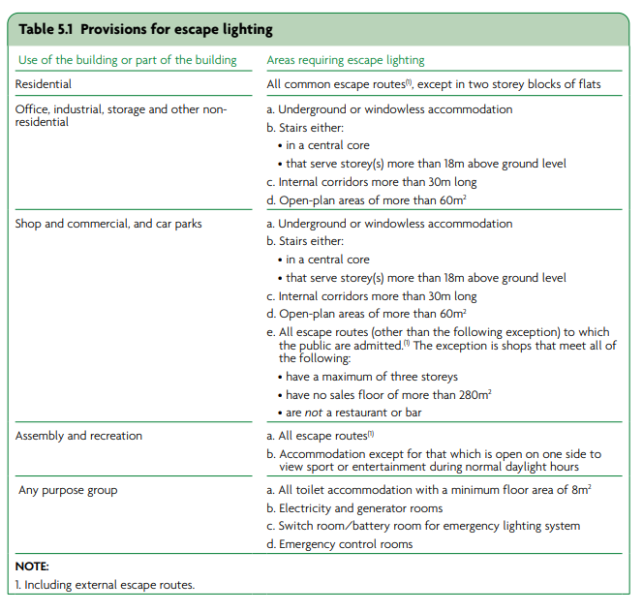
Escape lighting

Slide 34
Competency Statements
An example of how I applied my knowledge of Building control Law was project 2……………in my work portfolio. The project was alterations to the internal layout of the 6th floor of a 10 storey office block.
Building regulations applied because it was a material alteration as described in regulation 3(1)c of the principal regulations. (part B1 potentially being affected)
The applicant chose the approved inspector route completing our application form giving permission to sign initial notice on their behalf.
Basically go through process quoting every bit of law applicable
The project included emergency lighting …………..

Slide 35



Get in touch
abca.uk
admin@abca.uk
Association of Building Control Approvers (ABCA)

