Slide 1
Safety Management Andy Crooks, Stroma BC

Slide 2
In today’s session:
The BICOF requirements
Code of Conduct obligations
Safety arrangements
In house
On-site
Reporting using CDM/HSE

Slide 3
BICOF General Requirements
On the wheel, it is classed as a Management Competence
Measured by:
A – Awareness – basic knowledge of the subject and how it relates to the role
B – Appreciation – general background knowledge; appreciate intention; acknowledgement that specialist input may be required
C – Sufficient knowledge and understanding of legal and technical factors to make informed assessments and decisions relating to typical building work; acknowledged that specialist input may be required.
D – Sufficiently detailed knowledge, understanding and skills to make decisions on non-standard issues and the ability to commission and interrogate specialist assistance

Slide 4
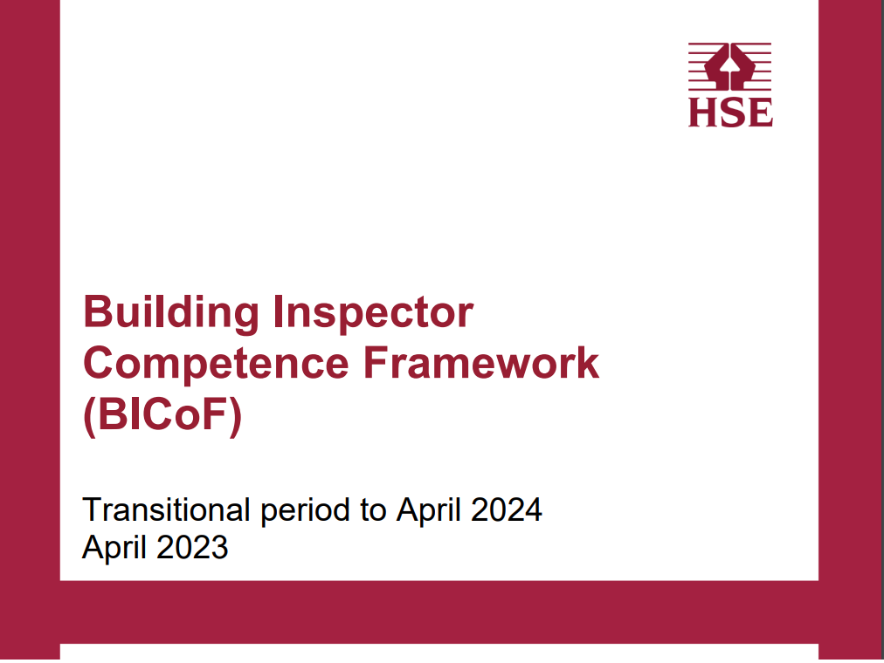
Roles and competence levels
Class 1 Trainee Building Inspector – Competent to level A and B
Class 2 Building Inspector – to level C
Class 3 Specialist Building Inspector – to level C
Class 4 Technical Manager – to level D

Slide 5
Safety Management competence
Level A – Awareness
Underpinning H&S legislation
BC’s role through design, approval, construction, inspection, certification, occupation and use of finished development
Role BC can play in promotion and leadership of safety culture
Controlling risk within the built environment
Reporting to the relevant enforcing body
Level B – Appreciation
All of the above, plus effective communication with interested parties
Level C – Understanding
All of the above, plus reference to CoC for RBIs
How BC supports compliance in HRBs and non-standard buildings
Level D – Comprehensive understanding
All of the above, plus the role of Building Safety Management to achieve BR compliance
Building Safety Management to ensure good practice in multi-disciplinary teams.
Notes:
Safety management - skills, knowledge, experience and behaviours (indicative examples)
Level A competence criteria – awareness of:
• terminology relating to the maintenance of life, fire and structural safety and appropriate associated behaviours applicable in construction of the built environment
• the role of health and safety as applicable to building control related to all building types • the role of effective communication methods and styles deployed in the delivery of building control functions and activities in achieving safety
• the culture of the construction industry
• personal safety, the safety of others and safe systems of work
• risk identification, assessment methodology and management for all building types
• health and safety legislation and practice, with an emphasis on the built environment
• construction, design and management legislation
• identification, raising concerns, effectively reporting to appropriate parties, and recording safety management incidents identified during assessment and inspection
Level B competence criteria – appreciation of:
• level A criteria
• building safety management and how these processes interact with the building control functions including plans assessment and inspection
Level C competence criteria – understanding of:
• level A and B criteria
• how to demonstrate effective safety management when carrying out building control for all building types excluding non-standard buildings and/or HRBs, from concept to design, approval, construction, inspection, enforcement, certification, occupation, and end use Building Inspector Competence Framework (BICoF): April 2023 34
• how building safety management behaviours compliment adherence to the Code of Conduct for Registered Building Inspectors and relevant organisational standards
Level D competence criteria – comprehensive understanding of:
• level A, B and C criteria
• How to demonstrate effective safety management when carrying out building control for all building types including non-standard buildings and/or HRBs, from concept to design, approval, construction, inspection, enforcement, certification, occupation, and end use
• How the use of building safety management supports effective participation and delivery of compliant buildings through multi-disciplinary teams

Slide 6
Legal background
Health and Safety at Work etc. Act 1974:
Prescribes general duties on employers
Inductions, instructions, training and supervision
Safe working environments
Personal protective equipment
Adequate first aid
Accident and incident reporting
Safety Committees
Employees must:
Take reasonable care of their health and safety
Stop if they have safety concerns
Ensure we don’t put others at risk
If we have concerns, inform the relevant parties
Report accidents and near misses

Slide 7
Common themes – what does your employer have in place?
Occupational Health and Safety Commitment
Familiarise yourself with the employer’s policies, SOPs and risk assessments
Standard operating procedures (SOPs)
Employers document their risks and who is responsible
How do they control? Relevant risk assessments
Legal registers
Some will sign up for various schemes to verify their commitments:
BS EN ISO 45001 – Occupational Health and Safety Management System
CHAS scheme
Safe contractor's schemes

Slide 8
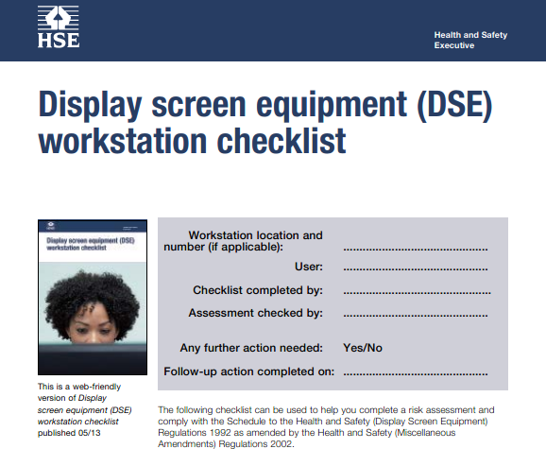
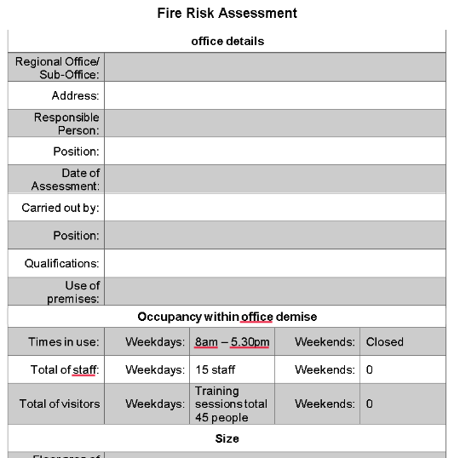
Safety Arrangements – In-house
Office risk assessments
Office itself
Display screen equipment
Fire Risk assessments/fire drills/maintenance of equipment
Mechanisms for review when things change
Office lone-working practices
First aiders/kits etc

Slide 9
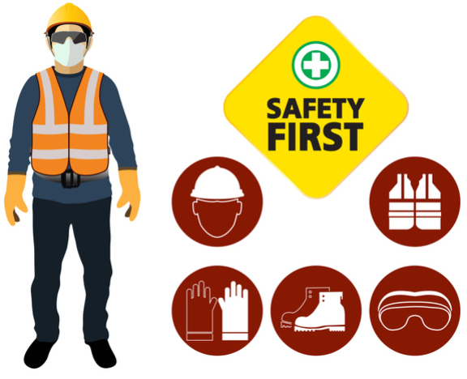
Site safety arrangements
Lone working policy
Who knows where you are?
Arrangements for signing out and in
What happens if someone isn’t accounted for?
Personal Protective Equipment (PPE)
Always wear it
Mechanism for regular review

Slide 10
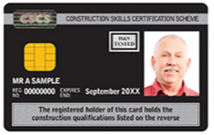
Site Safety Arrangements – Level D
Driver risk assessments
Driving license/MOT/Insurance
Accident and near-miss reporting
Site risk assessments
Site risk training
Asbestos awareness training

Slide 11
Construction Design & Management Regulations 2015
It is about securing construction health and safety:
Managing risks
Appointing the right people at the right time
Information, instruction, training & supervision
Cooperation, coordination & communication
Consultation & engagement of workers
It applies to all construction work
You play no part in its enforcement, but you can use it to report health and safety matters which you see on site.
YouTube link to CDM Regs Seminar CABE 2017

Slide 12
Notifications & Enforcement
See something? Then notify the site immediately
Notify the Principal Contractor
If he seems disinterested – then notify the Principal Designer
If the ‘something’ remains a concern
Report it to your line-manager, Director for advice
Ultimately, the issue will be reported to the HSE
HSE CDM Page
Weblink includes various guides
Detailed role of Principal designers, contractors and client
Reporting links for incidents and complaints
Possible Enforcement
On-the-spot fines
Prison sentence
Unlimited fine for offences

Slide 13
General Conclusion
Observe procedures
Do not put yourself at risk
Notify others when you perceive they may be at risk
If in doubt, walk away

Slide 14
Thanks for listening, Any questions?

